Slide 1
A Journey with Database Engineering
Hasan Mahmud Rhidoy
Software Development Engineer, BRAC IT
Dhaka, Bangladesh

Slide 2
What is Database
A database is an organized collection of data, so that it can be easily accessed and managed.
You can organize data into tables, rows, columns, and index it to make it easier to find relevant information.
The main purpose of the database is to operate a large amount of information by storing, retrieving, and managing data.
There are many databases available like MySQL, Sybase, Oracle, MongoDB, Informix, PostgreSQL, SQL Server, etc.
SQL or Structured Query Language is used to operate on the data stored in a database. SQL depends on relational algebra and tuple relational calculus.

Slide 3
Advantages of DBMS
Controls database redundancy
Data sharing
Easily Maintenance
Reduce time
Backup
Multiple user interface

Slide 4
Disadvantages of DBMS
Cost of Hardware and Software
Higher impact of failure

Slide 5

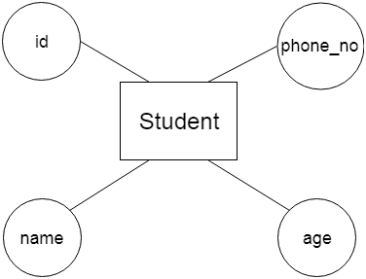
ER model
Entity: An entity may be any object, class, person or place. In the ER diagram, an entity can be represented as rectangles.
Attribute: The attribute is used to describe the property of an entity. Eclipse is used to represent an attribute.

Slide 6




Relationship: A relationship is used to describe the relation between entities.
One-to-One Relationship:
One-to-many relationship
Many-to-one relationship
Many-to-many relationship

Slide 7
MySQL vs SQL
MySQL is a relational database vendor which uses SQL language
On the other hand SQL is a query language which deals with database.

